Slide 1
Cyber Security and Forensics AICT014-4-2-CSF Version VE3
Forensic Tools and Techniques

Slide 2
Topic & Structure of The Lesson
Digital forensic investigation categories:
Acquisition
Examination
Presentation
Evidence extraction
Physical vs logical
Capturing contents of RAM

Slide 3
Learning Outcomes
At the end of this topic, you should be able to
Explain categories of digital forensic investigation
Discuss how evidence extraction is performed
Describe steps involved in capturing contents of RAM

Slide 4
Key Terms You Must Be Able To Use
If you have mastered this topic, you should be able to use the following terms correctly in your assignments and exams:
Digital forensic investigation categories:
Acquisition
Examination
Presentation
Evidence extraction: physical vs logical

Slide 5
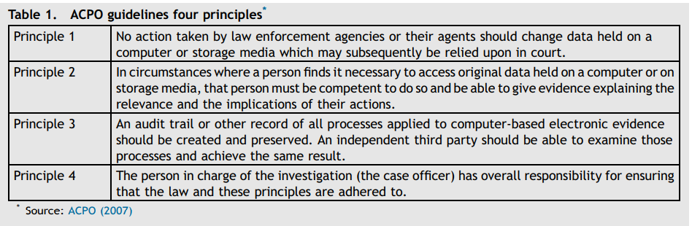
ACPO
Association of Chief Police Officers of England, Wales & N. Ireland
Good Practice Guide for Digital Evidence
Good Practice Guide for Managers of e-Crime investigation
Irrespective of the size or complexity of the case the investigator should consider five primary stages.
1. Capture (search and seizure at crime scenes);
2. Examination;
3. Interpretation;
4. Reporting;
5. Interview of
Witness
and Suspects.

Slide 6
Zatyko, 2007
“Forensic science” (often shortened to forensics) is the application of a broad spectrum of sciences to answer questions of interest to the legal system. This may be in relation to a crime or to a civil action.
8-phase digital forensics process:
Search Authority
Chain of Custody
Imaging/Hashing Function
Validated Tools
Analysis
Repeatability (Quality Assurance)
Reporting
Possible Expert Presentation
http://www.forensicmag.com/article/2007/01/commentary-defining-digital-forensics

Slide 7
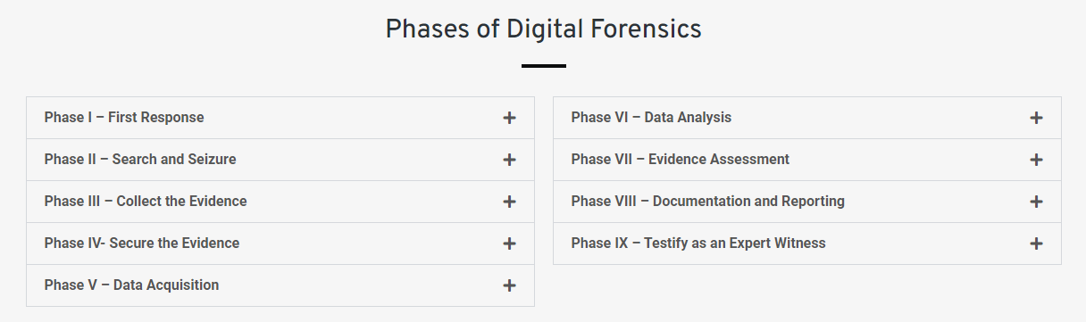
EC-Council: Digital Forensic Investigation
https://www.eccouncil.org/cybersecurity/what-is-digital-forensics/

Slide 8
Digital Forensics Phases
Acquisition
Examination
Presentation

Slide 9


Strategy
Different type of cases apply similar steps, but details of actions are different due to the nature of crime.
Need to know the important activities in a given crime to identify the correct evidence

Slide 10
Steps to Prepare for a Computer Forensic Investigation
Identify
Identify the type of data you are seeking, the information you are looking for, and the urgency level of the examination
Secure
Secure any relevant media –including hard drives, laptops, cell phones, CD-ROMs, DVDs, USB drives, and MP3 players –the subject may have used
Initialize
Initialize a "chain of custody" for each piece of original media, indicating where the media has been, whose possession it has been in, and the reason for that possession
Note
If a device was accessed before the forensic expert is able to secure a mirror image, note the user(s) that accessed it, what files they accessed, and when this occurred.

Slide 11
Steps to Prepare for a Computer Forensic Investigation (cont’d)
Obtain
Obtain information about the computer hardware where the media was used, and the peripherals and the network to which it was connected
Obtain
Obtain passwords to access encrypted or password-protected files, if possible
Compile
Compile a list of names, e-mail addresses and other identifying information about those with whom the subject might have communicated
Develop
Develop a list of key words or phrases to use when searching for relevant data

Slide 12

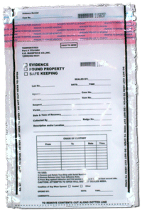
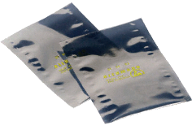
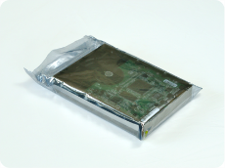
Crime Scene Processing Tools
Cameras
Notepads
Sketchpads
Evidence forms
Crime scene tape
Markers
Disassembly Tools
Cable tags
Stick-on labels
Evidence bags
Anti-static packaging for magnetic media

Slide 13


First Responder
Persons attending a scene should be especially aware that systems which are powered on (running) need to be handled with care, as there is the potential to make unwanted changes to the evidence, and volatile data of value may be lost if these are not dealt with correctly.

Slide 14

Documentation
When attending a scene, records must be kept of all actions taken in relation to digital evidence.
Photographs/diagrams of equipment locations
Details of any information provided by persons present
Records of any actions taken at the scene

Slide 15
Acquiring Digital Evidence
Prepare
Prepare separate media for evidentiary files and data
Use “disk wiping” software to remove traces of old data
Create working directories
Perform
Perform the acquisition using the examiner’s system.
Configure the examiner’s system to recognize the storage device
Write protection hardware or software should be used to preserve the original evidence
Boot with an examiner-controlled and verified operating system
Create
Create a known value for the subject evidence
Cyclic Redundancy Check (CRC): An error-detecting code commonly used in digital networks and storage devices to detect accidental changes
MD5 hash

Slide 16
Evidence Extraction
• Two different types of extraction:
– Physical extraction identifies and recovers data across the entire physical drive without regard to file system.
– Logical extraction identifies and recovers files and data based on the installed operating system(s), file system(s), and/or application(s).

Slide 17
Physical Extraction
Extraction of the data from the storage device done at the physical level regardless of file systems present on the drive.
Examining the partition structure may identify the file systems present and determine if the entire physical size of the drive is accounted for.
Performing a keyword search across the physical drive may allow the examiner to extract data that may not be accounted for by the operating system and file system.
File carving utilities may assist in recovering and extracting useable files and data that may not be accounted for by the operating system and file system.

Slide 18
Logical Extraction
Extraction of the data from the drive is based on the file system(s) present on the drive.
• Examining file system information: file name, size, location, attributes, date and time stamps
• Recovery of deleted files.
• Data reduction to identify and eliminate known files through the comparison of calculated hash values to authenticated hash values.
• Extraction of files pertinent to the examination, based on file name and extension, file header, file content, location on the drive.
• Extraction of password-protected, encrypted, and compressed data.
• Extraction of file slack.
• Extraction of the unallocated space.

Slide 19

Tools: Considerations
There is a large selection of tools and integrated packages available for the analysis of hard-disk and other stored data.
Certain proprietary tools are only made available by their publishers to law enforcement.
Prosecution experts have to take particular care to anticipate a defence expert may wish to test their findings, and to consider how they are to be in a position to do so.

Slide 20

Tools: Considerations
In some cases, the actual evidence recovered may be just a few files, a single file or a few bytes of data.
In these cases it is highly recommended that the examination is repeated with a totally different software process and tool.
The repeat of the examination should conclude in the report of the same result, thus giving each ‘nugget of gold’ more reliability and credibility.

Slide 21

Analysis of Extracted Data
Analysis is the process of interpreting the extracted data to determine its significance to the case.
Examples of analysis that may be performed include
Application and file
Timeframe
Data hiding
Ownership and possession

Slide 22
Application and File Analysis
Activities include:
Reviewing file names for relevance and patterns
Correlating files to installed applications
Examining file content
Analyzing file metadata, typically through the application that created it
Considering relationships between files
For example, correlating Internet history to cache files and e-mail files to e-mail attachments
Identifying unknown file types to determine their value to the investigation
Examining user-configuration settings
Determining if files have been stored in the default location for the application or an alternate location
Results of this analysis may indicate that additional extraction and analysis is required

Slide 23


Timeframe Analysis
Determining when events occurred on a computer system can be used to associate and individual with usage of the computer
Reviewing the time and date stamps in the file system metadata to link files of interest to the timeframes relevant to the investigation.
– Example: using the last modified date and time to establish when the contents of a file were last changed.
• Reviewing system and application logs
– Example: a security log may record username/password combination used to log into a system.
However, accuracy is an issue

Slide 24

Caution
The operating system relies on the date and time reported by the BIOS
Over time, the system clock will “drift” away from the true time
When computers are running on different times, it becomes almost impossible to accurately match actions logged on different computers.
Even the smallest inaccuracy can bring into question the validity of the entire set of data.

Slide 25
Network Time Protocol (NTP)
NTP is an Internet standard protocol (built on top of TCP/IP) that assures accurate synchronization to the millisecond of computer clock times in a network of computers.
Running as a continuous background program, NTP sends periodic time requests to servers, obtaining server time stamps and using them to adjust the local BIOS clock.
NTP servers normally sync to an extremely accurate “atomic clock”

Slide 26
Data Hiding Analysis
Hidden data may indicate a deliberate attempt to avoid detection
Correlating the file signatures to the corresponding file extensions to identify mismatches.
mismatches may indicate that the user intentionally hid data
Gaining access to password-protected, encrypted, and compressed files
These measures indicate an attempt to conceal the data from unauthorized users.
A password itself may be as relevant as the contents of the file.
Installed software might offer clues that the suspect hides files inside other files.
Users with binary (hex) editors, disk wiping software, steganographic or specialized chat software might demonstrate an inclination to alter files and keep information secret.

Slide 27

Data Hiding Analysis
Multimedia “carrier” files
While a standard Windows computer will contain thousands of graphics and audio files, the vast majority of these are very small and are an integral part of the graphical user interface.
A system with an especially large number of files that could be steganographic carriers is potentially suspect, particularly if there are a significant number of seemingly duplicate "carrier" files.

Slide 28

Ownership and Possession
It may be essential to identify the individual(s) who created, modified, or accessed a file.
It may also be important to determine ownership and knowledgeable possession of the questioned data.
Evidence of knowledgeable possession may be based on other types of analysis.

Slide 29
Ownership and Possession
[Application and file analysis]
Files of interest may be located in non-default locations (like a directory named “porn”)
The file name itself may be of evidentiary value if it indicates the contents of the file
Contents of a file may contain metadata or other information specific to a user
[Timeframe analysis]
Placing the subject at the computer at a particular date and time may help determine ownership and possession
[Hidden data analysis]
Hidden data may indicate a deliberate attempt to avoid detection
If the passwords needed to gain access to files are recovered, knowledge of the passwords themselves may indicate possession or ownership

Slide 30
Capturing Contents of RAM
In certain circumstances, it may be necessary or advisable for computer forensic investigators to gather evidence from a computer whilst its running or in a ‘live’ state.
In order to capture volatile data on a device the device WILL have to be accessed. Therefore changes to original evidence WILL be caused by the examiner.
Even though some changes to the original evidence will be made, this technique has become more common with the increase in advanced malware, where evidence cannot always be retrieved using more traditional disk forensics.

Slide 31

Capturing Contents of RAM
Conducting live-forensics implies access to the original evidence and making controlled changes to it.
Any person doing this needs to be competent and fully aware of the impact their actions have and should be prepared to explain their reasons for taking this route.
a conscious decision will have to be made and the process written down.
If other forensic tools are used before the contents of the RAM are stored, it is very likely that they will overwrite parts of the RAM. Therefore capturing the contents of RAM needs to be done first.

Slide 32
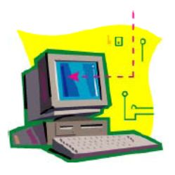
Capturing Contents of RAM
Examples of information which might be available in the dump of the RAM contents:
List of running processes;
Logged on and registered users;
Registry information.
Application footprint (especially important for malware analysis)

Slide 33

Capturing Contents of RAM
In order to ensure that a consistent approach is used, and the chance of errors is minimized, it is recommended to use a script to call a number of basic and trusted tools.
By profiling the footprint of these trusted forensic tools, the digital forensic examiner can understand the impact of using such tools and can explain any artefacts left by the tools.

Slide 34

Capturing Contents of RAM
The tools used to capture this volatile information are generally run from removable media like a USB stick,
Writing output to the original drive should be avoided whenever possible, as this changes the contents of the hard drive and can destroy potential evidence.
When inserting USB devices, the examiner must ensure that they know the details of the serial numbers of the devices they are connecting so that they can be eliminated when analyzing the date captured.

Slide 35
Capturing Contents of RAM
Summary of steps
Documentation of all actions, together with reasoning, is implicitly included in the process when following such steps:
Perform a risk assessment of the situation – Is it evidentially required and safe to perform volatile data capture?
If so, plug the volatile data capture (such as a USB stick) into the machine and start the data collection script;
Once complete, stop the device (particularly important for USB devices, which if removed before proper shutdown can lose information);
Remove the device;
Verify the data output on a separate forensic investigation machine (not the suspect system);
Immediately follow with standard power-off procedure.

Slide 36
Step-by-Step
Select a disk or partition with a capacity of at least double the evidence size
Wipe (fill the disk with zeros) the disk for the image.
Mount the freshly prepared read-write image disk.
Create a directory for all documentation and analysis /image.disk/case_id
Create a sub-directory to hold the evidence image /image.disk/case_id/evidence_id
Document details of the investigation including
investigator’s details
case number, case background details
investigation dates
scope of the investigation

Slide 37
Step-by-Step
Document details of the disk media including
media evidence number,
make, model, and serial number of the disk,
size and total number of sectors on the drive.
source of the disk
Document details of the investigative action including
date and time of imaging
make, model, and serial number of computer
IP and system hostname
Mount the disk to be imaged as read only (or use a write blocker)
Create an MD5 hash of the disk to be imaged and save it to the image disk
Create the disk image in the proper folder

Slide 38
Step-by-Step
Change the file permissions of the image to read-only
Create an MD5 hash of the disk image and compare the result to the MD5 hash of the original device
Mount the disk image to extract evidence
View the contents of the disk: all files including hidden files and the directories
Make a list of all files along with access times
Identify locations of
System files
configuration files
applications
data files
deleted files

Slide 39
Step-by-Step
Match file types (extensions) to applications
List unknown file extensions and changed file appearances
Depending on the scope of the examination, search for likely evidence using keywords, and perform further detailed analysis and logical extraction to support
Application and file analysis
Timeframe analysis
Data hiding analysis
Ownership and possession analysis

Slide 40
Quick Review Question
Quizizz.com
CSF - Investigation Methodology

Slide 41
Summary of Main Teaching Points
Take a systematic approach to investigations
Take the nature of the case, instruction, and tools into account while planning the case
Apply standard problem-solving techniques
Copy and preserve the original evidence
Avoid dealing with the original evidence
Create bit-stream copies of files
Create hash values for every softcopy
Document everything
Maintain chain of custody

Slide 42

Q & A

